Slide 1

PGA Golf Tour 2017
Sydney Scaccia
Final Project DSC 503

Slide 2
Motivation

Slide 3
“Physical Skill Factors contribution to success on the professional golf tour”
Shows relationship between driving techniques and green in regulation percent

Slide 4

“What three factors influence golf distance”

Slide 5

“Where do golf drivers go wrong? Factors influencing driver swing consistency”

Slide 6
Hypothesis/research question
Research Question: How much does the technique of a golfer's swing impact the distance the drive travels?
Null Hypothesis: The technique of the swing does not impact the distance of the drive.
Alternative Hypothesis: The technique of the swing does impact the distance of the drive.

Slide 7
Variables
Independent Variable: average driving distance
Dependent Variable: the total number of drives, the average club head speed, the average ball speed, the average smash factor or how hard the club hits the ball, the average launch angle, the average spin rate, the average hang time and the average carry distance

Slide 8
Variable Associations
x1 was the average ball speed
x2 was the average spin rate
x3 was average carry distance
x4 was average hang time
x5 was the total number of drives
x6 was the average club head speed
x7 was the average smash factor
x8 was the average launch angle
Y is still our distance of the initial drive.

Slide 9
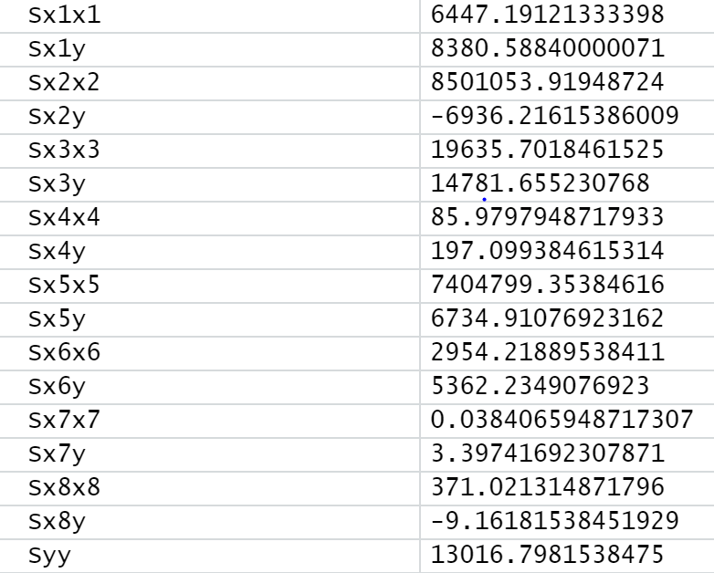

Slide 10
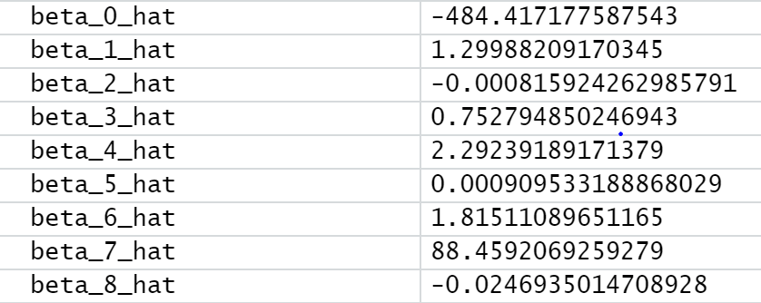
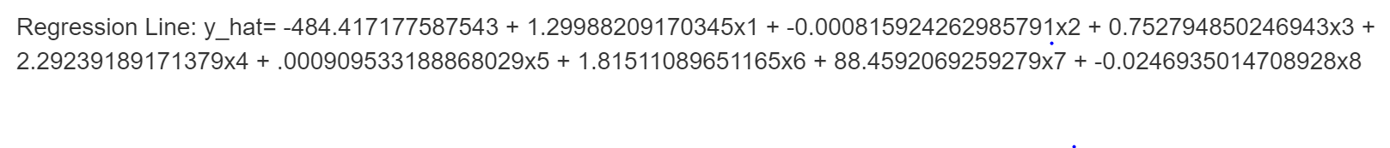

Slide 11
Hypothesis Testing
Alpha level .05
Conducting the hypothesis test on the slope
Returned False
Conducting the F- Test
Returned True

Slide 12
Interpretation
As the golfers swing speed increases by 1, the ball's speed increases by 1.299882.
Once the ball is hit, and the revolutions increase by one the spin rate on the ball loses .0008159243 revolutions the further it travels
When the ball is in the air, and gains one yards, the carry distance increases by .7527949
As the time increases by one second, the hang time increases 2.292392 seconds
As the number of drives increases by one, the distance increases by .0009095332 yard
As the club head speed increases by one mile per hour, the distance of the drive increases by 1.815111 yard
As the smash factor of the ball increases by one, the transformation from club head speed to ball speed increases by 88.45921 miles per hour
As the launch angle increases by one degree, the ball loses .0246935 in distance

Slide 13
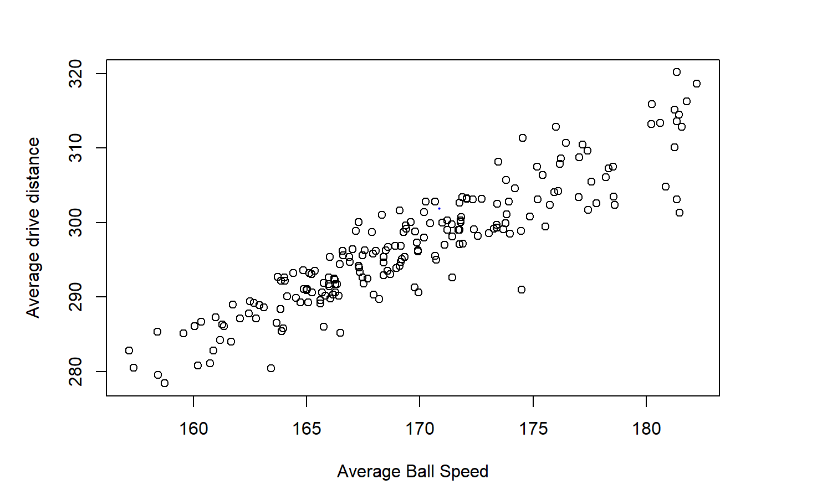
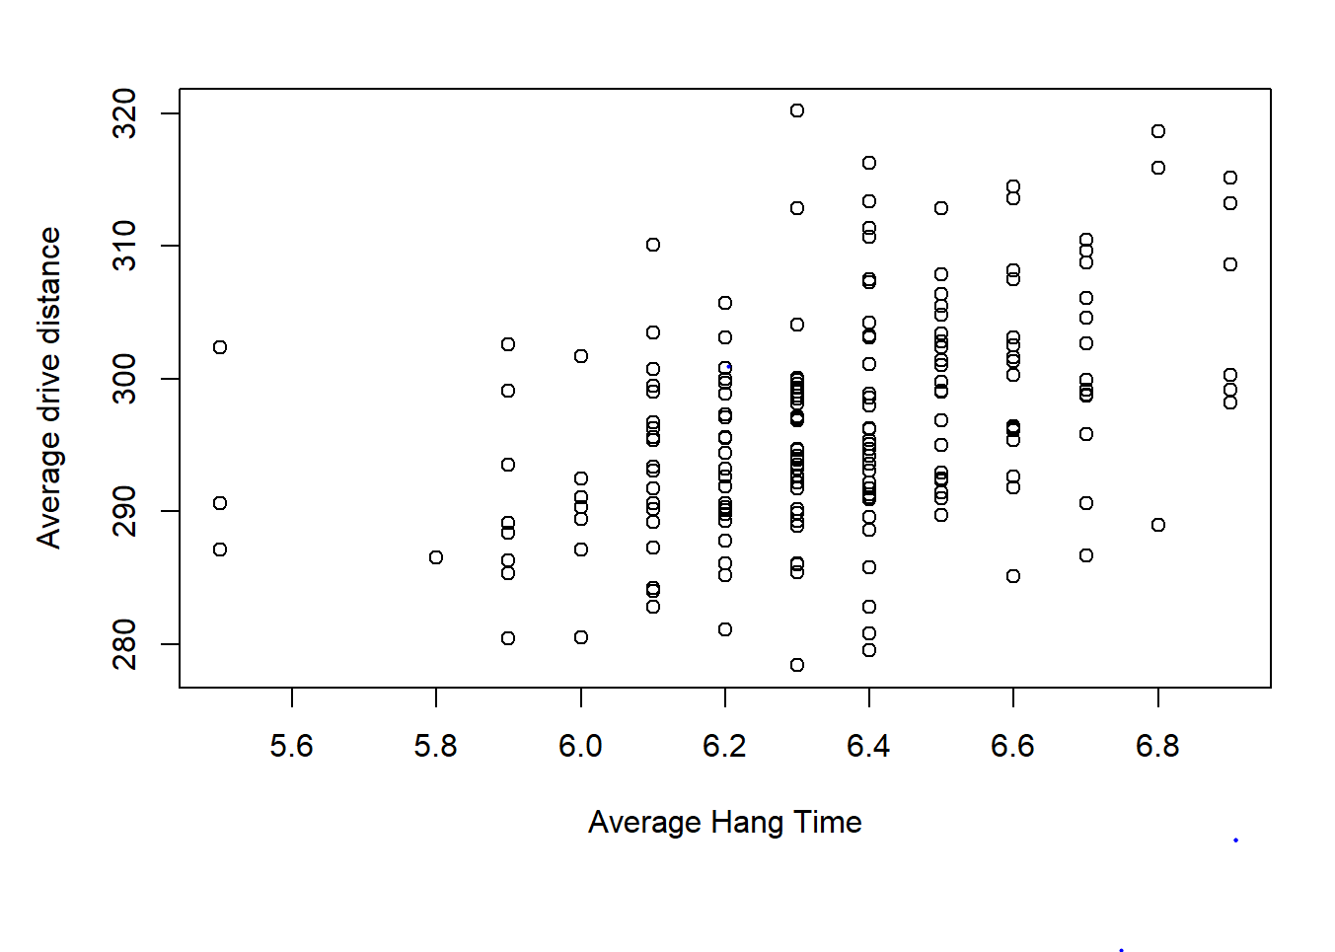
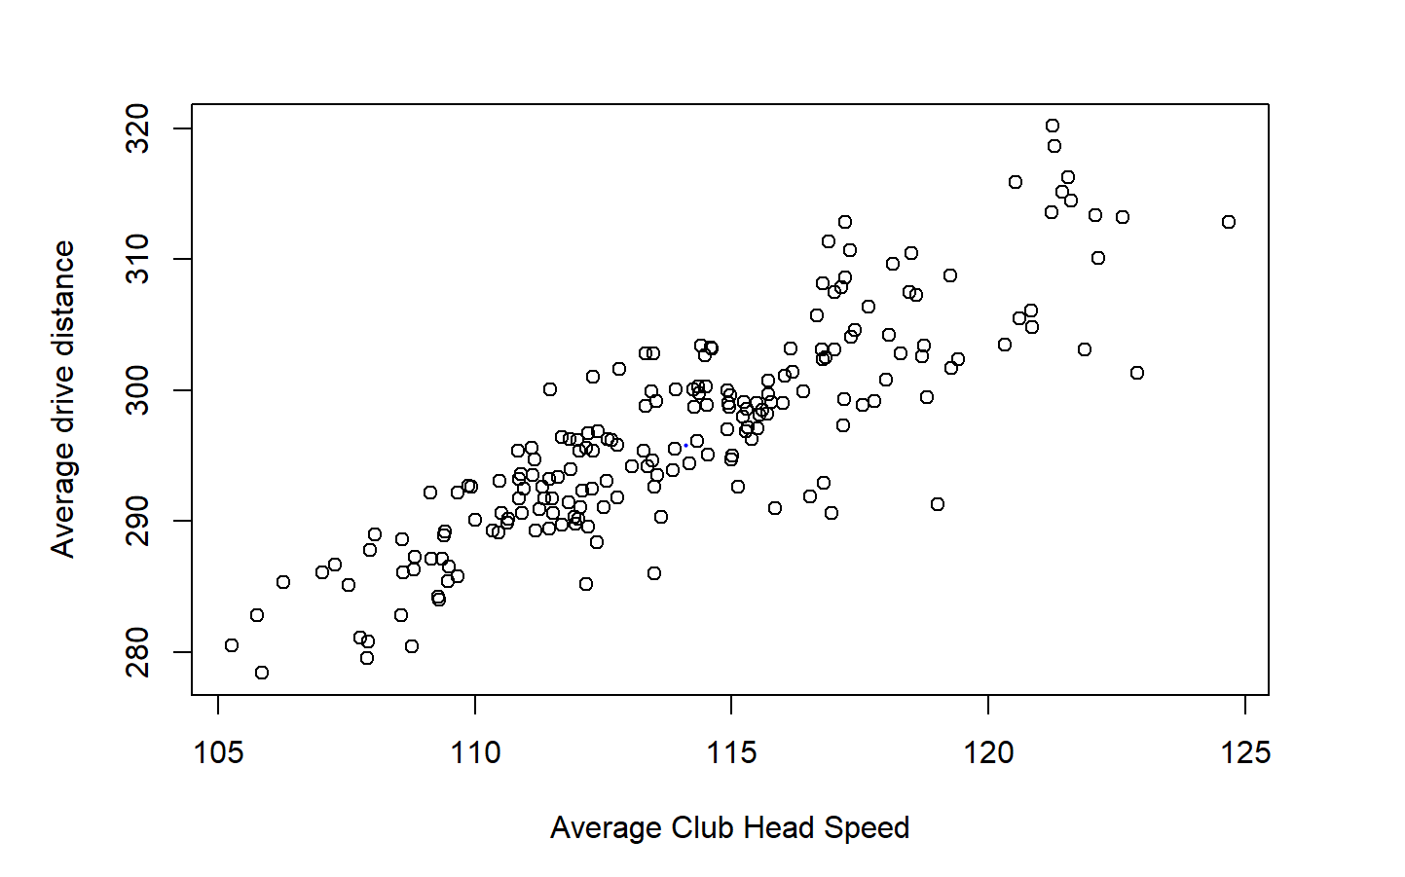

Slide 14
References
Nix, Charles L., and Robert Koslow. “Physical Skill Factors Contributing to Success on the Professional Golf Tour.” Perceptual and Motor Skills, vol. 72, no. 3_suppl, 1991, pp. 1272–1274., doi:10.2466/pms.1991.72.3c.1272.
“What 3 Factors Influence Golf Distance?” JacksGolfingSolutions.com, www.jacksgolfingsolutions.com/what-3-factors-influence-golf-distance.html.
Zhang, X., and G. Shan. “Where Do Golf Driver Swings Go Wrong? Factors Influencing Driver Swing Consistency.” Scandinavian Journal of Medicine & Science in Sports, vol. 24, no. 5, 2013, pp. 749–757., doi:10.1111/sms.12061.

